Slide 1
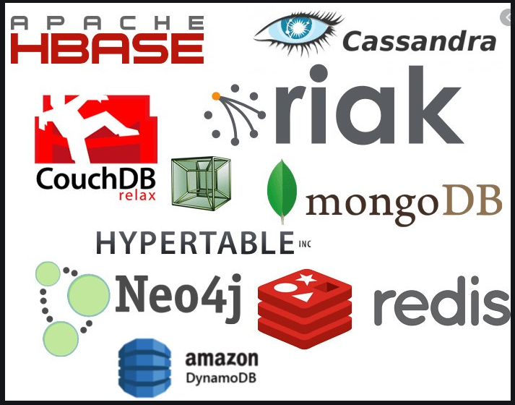

Different Types
of
NoSQL
Databases
PART-1

Slide 2
NoSQL : Context
Non-relational or NoSQL databases were born out of the rigidity of traditional relational or SQL databases, which use tables, columns, and rows to establish relationships across data.
Developers welcomed NoSQL databases because they didn’t require an upfront schema design; they were able to go straight to development.
And it’s this flexibility – this “ad-hoc” approach to organizing data – that has arguably been NoSQL’s greatest selling point.
NOSQL continues to appeal to companies that need to store unstructured or rapidly changing data.

Slide 3

NoSQL Database Types
In this video, we’ll go through the five main types of NoSQL databases:
Wide-Column Store
Document Store
Key-Value Data Store
Graph Store
Multi-Model

Slide 4
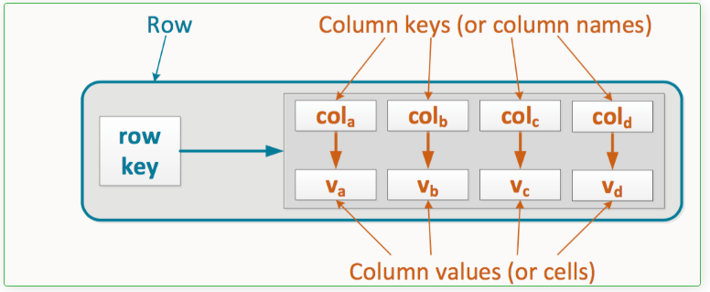

NoSQL : Wide-Column Store
As the name suggests,
wide-column stores use columns to store data.
Related columns are grouped into column families.
Individual rows then constitute a column family.
Let's look it visually. Here’s what an individual row within a column family looks like in Cassandra:
A typical column family :
contains a row key as the first column, which uniquely identifies that row within the column family.
The following columns then contain a column key, which uniquely identifies that column within the row, so that you can query their corresponding column values.

Slide 5
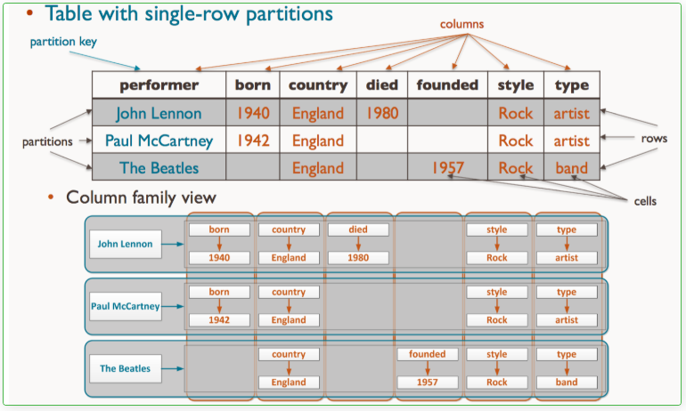

NoSQL : Wide-Column Store
Here’s how data in a table would translate to a column family:
Examples of Column Databases : Cassandra , HBase

Slide 6

NoSQL : Wide-Column Store : Use Cases
Column stores offer very high performance and a highly scalable architecture.
Popular among companies and organizations dealing with big data, IoT, and user recommendation and personalization engines.
Spotify uses Cassandra to store user profile attributes and metadata about artists, songs, etc. for better personalization
Facebook initially built its revamped Messages on top of HBase, but is now also used for other Facebook services like the Nearby Friends feature and search indexing.
Outbrain uses Cassandra to serve over 190 billion personalized content recommendations each month

Slide 7

NoSQL : Wide-Column Store : Data Model
Data Model
ColumnFamily: ColumnFamily is a single structure that can group Columns and SuperColumns with ease.
Key: the permanent name of the record. Keys have different numbers of columns, so the database can scale in an irregular way.
Keyspace: This defines the outermost level of an organization, typically the name of the application. database name.
Column: It has an ordered list of elements aka tuple with a name and a value defined.

Slide 8
NoSQL : Wide-Column Store
will continue in next part ….
Thanks and do subscribe to my channel

